Slide 1
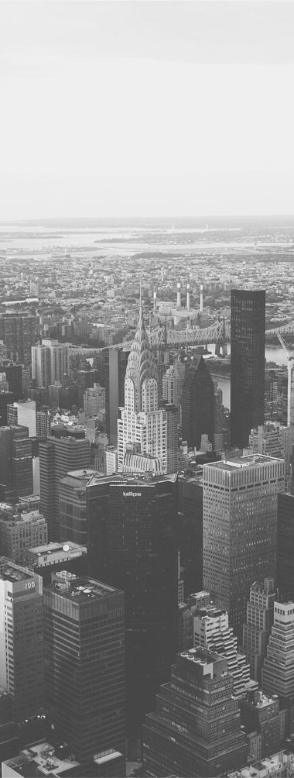
Protests vs. Pandemic:
Examining the Effects on Unemployment
Rate of the HKSAR INDUSTRIES through Clustering Algorithm
by Grace Sicat-Cayanan

Slide 2
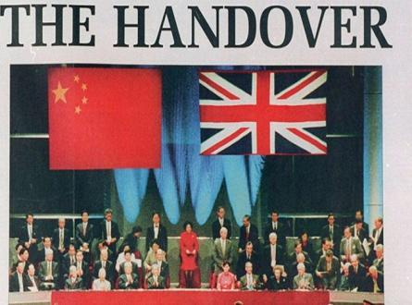
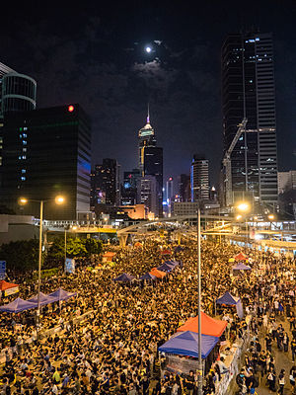
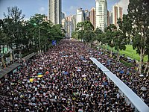
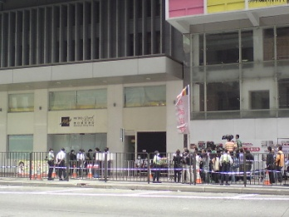
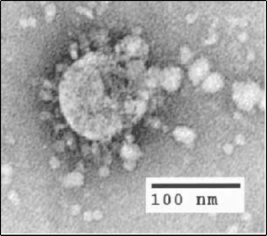
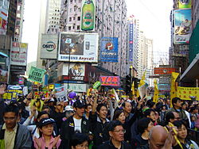
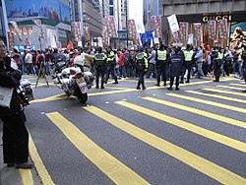
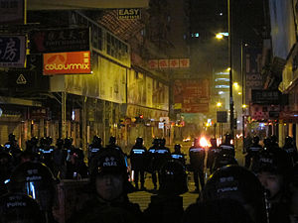
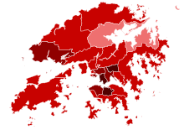
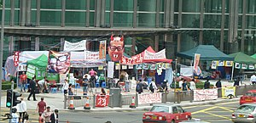
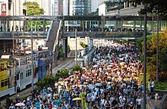
HKSAR TIMELINE OF EVENTS
UMBRELLA
REVOLUTION
EXTRADITION LAW PROTESTS
SWINE FLU
1. HKSAR EVENTS
2. UNEMPLOYMENT VS. UNDEREMPLOYMENT
1997
2009
2014
2019
3. EPIDEMIC VS PANDEMIC
1. EPIDEMIC VS. PANDEMIC
2003 - 2008
2010-2013
2015-2018
2020
SARS
DEMOCRACY
PROTESTS
NEW YR’S
MARCH &
DOCK STRIKE
ACTIVISTS’ IMPRISONMENT & FISHBALL REVOLUTION
COVID 19

Slide 3
LAYOFF RATES
50
40
30
There has been a MASSIVE INCREASE of unemployment RATES from the DIFFERENT INDUSTRIES in HKSAR since the coming of these events.
20
10
0
2016
2017
2018
2019
2020

Slide 4
MOTIVATION
1. HKSAR EVENTS
2. PROTESTS VS PANDEMIC
What are the events(years) in HKSAR that has the highest impact on the unemployment rate of the HKSAR industries?
Focusing on protests and pandemic, what has the highest effect on the unemployment of HKSAR industries?
3. GROUP OF INDUSTRIES
4. SPECIFIC INDUSTRIES
Among the group of industries, what has the highest unemployment rate during the protests and pandemic events?
Given the impact of these events, what are the specific industries that are more likely to survive in these type of events?

Slide 5
What is the effect of the HKSAR protests and pandemic events in the unemployment rates of the different industries?
PROTESTS vs. PANDEMIC
Notes:
AN EPIDEMIC is a disease that affects a large number of people within a community, population, or region. A PANDEMIC is an epidemic that's spread over multiple countries or continents. ENDEMIC is something that belongs to a particular people or country.

Slide 6

WHAT DATA ARE WE LOOKING?
320
31
12
2
YEARS
(TIMELINE OF EVENTS)
DATA
SETS IN CSV FILE FORMAT
ROWS
AND COLUMNS
Quarterly Months of Every Year
Grouped industries and enumerated industries
Total number of rows and columns of the two(2) data sets
General Household Survey, Census and Statistics Department, HKSAR
Last updated on: 21/10/2020
Update frequency: monthly/quarterly/ad hoc

Slide 7
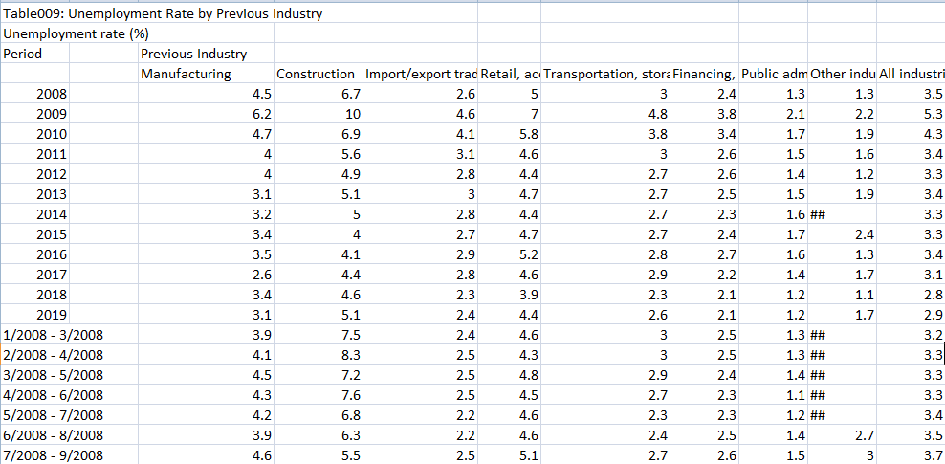
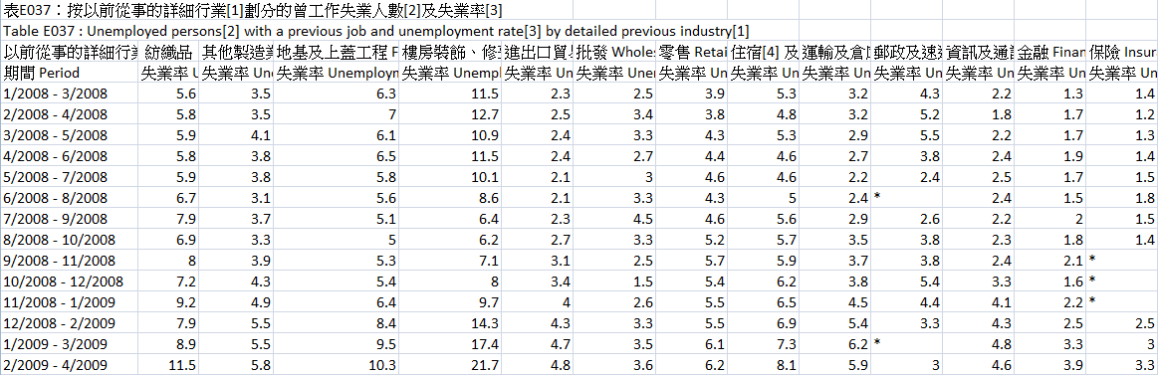
DATA SETS
1. GROUP INDUSTRIES DATA SET
2. SPECIFIC INDUSTRIES DATA SET

Slide 8
METHODOLOGY
Data Preprocessing
Transformation
to_numeric and astype functions
Partitioning of data frames
Transposing of data frames
Cleaning
Skip rows, footer and header
Regular Expressions
Integration
JOIN data frames
Column and Row Indexing
Reduction
Drop NaN values in rows and columns
String and regular expressions
Data Mining
Data and Pattern Evaluation
Pandas Profile Reporting
Correlation (Pearson’s R, Phik (φk))
Missing Values (Count and Heatmap)
Elbow Method
Sillhoutte Coefficient Method and Davies Bouldin Score
K-Means Clustering Algorithm
Data Presentation
Bar Plots / Bar Graphs
Heatmap
Scatter Plots
NEW!!!
NEW!!!

Slide 9
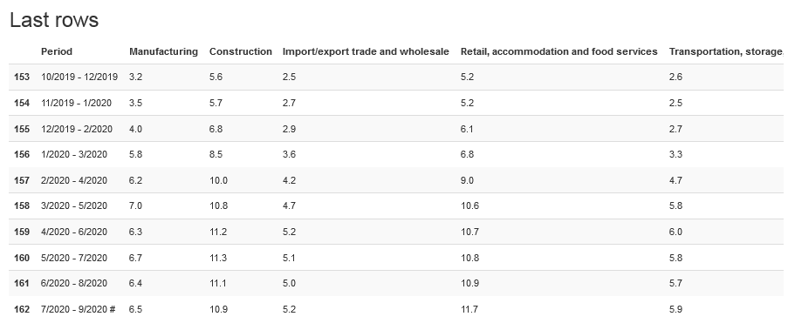
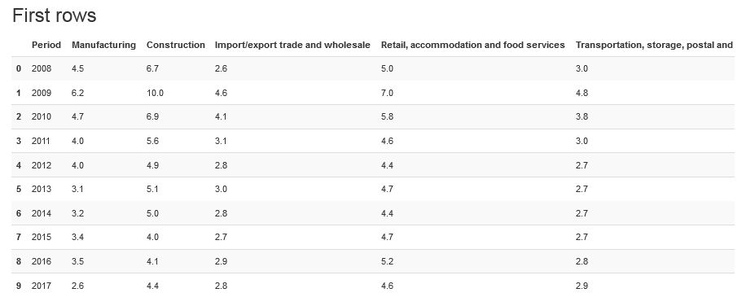
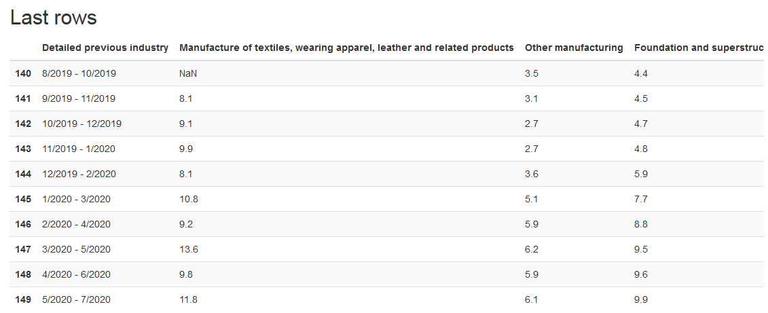
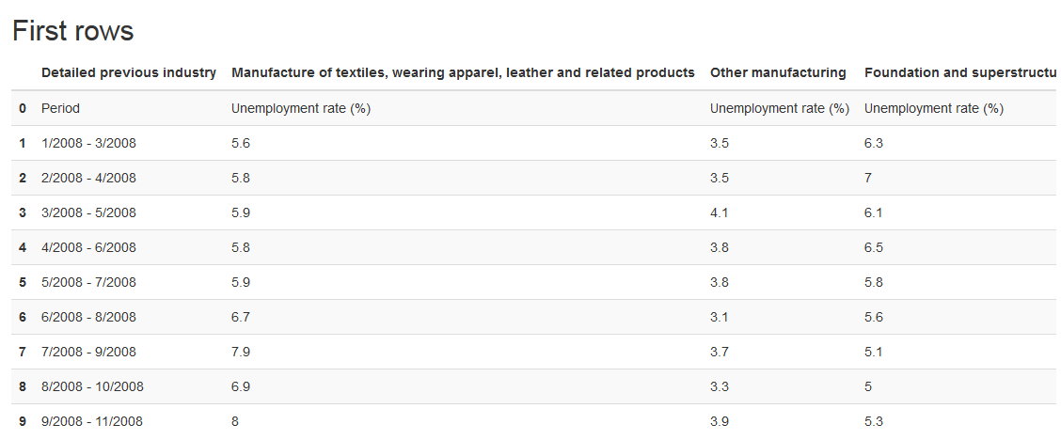
DATA PREPROCESSING
1. Group Industries Data Set
2. Specific Industries Data Set

Slide 10
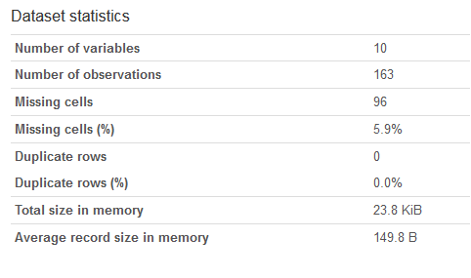
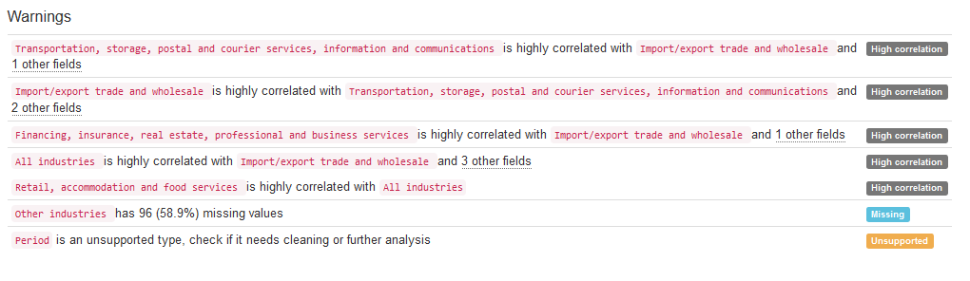
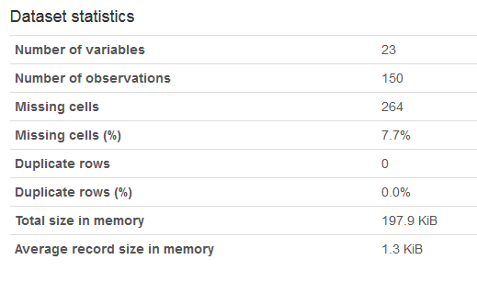
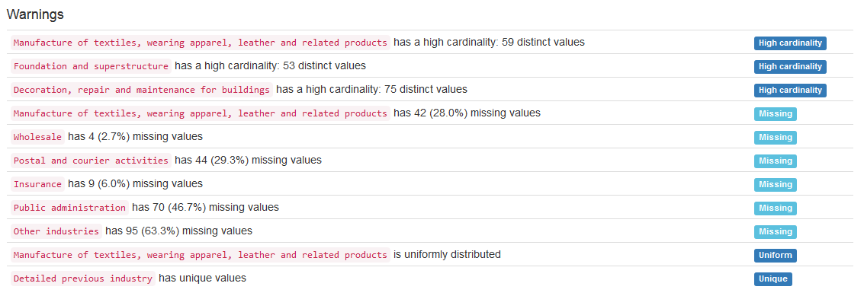
DATA EVALUATION
1. GROUPED INDUSTRIES DATA SET
2. SPECIFIC INDUSTRIES DATA SET

Slide 11
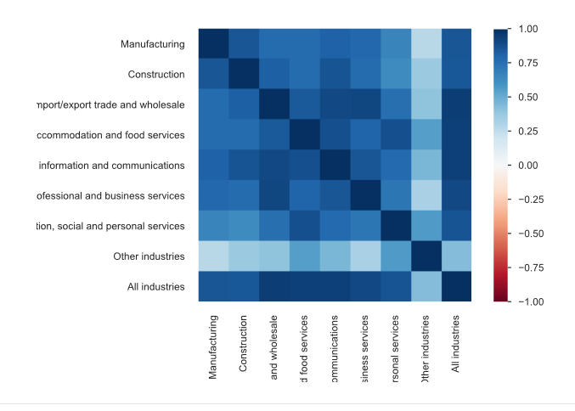
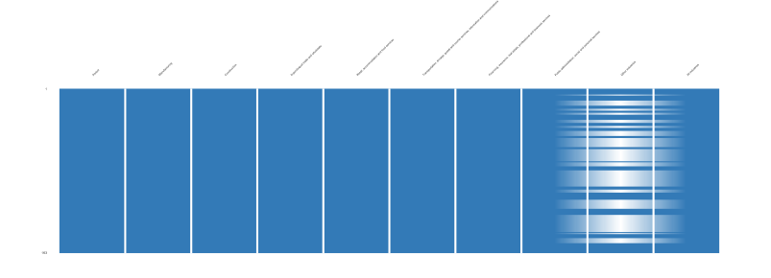
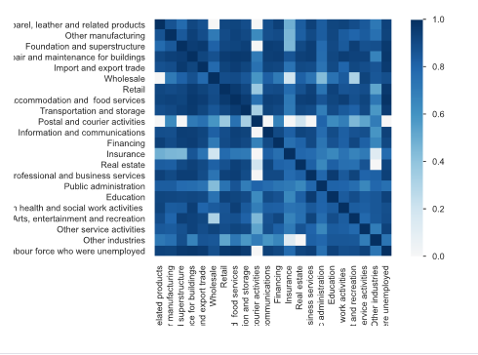
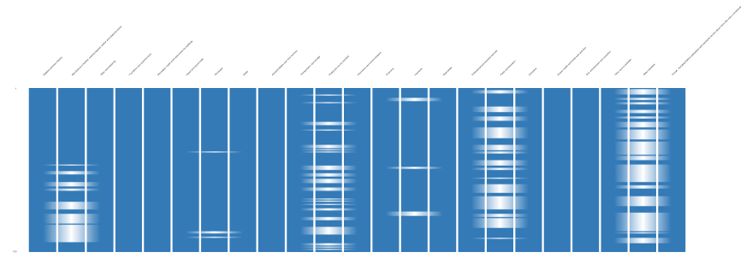
DATA EVALUATION
1. Group Industries Data Set
2. Specific Industries Data Set

Slide 12
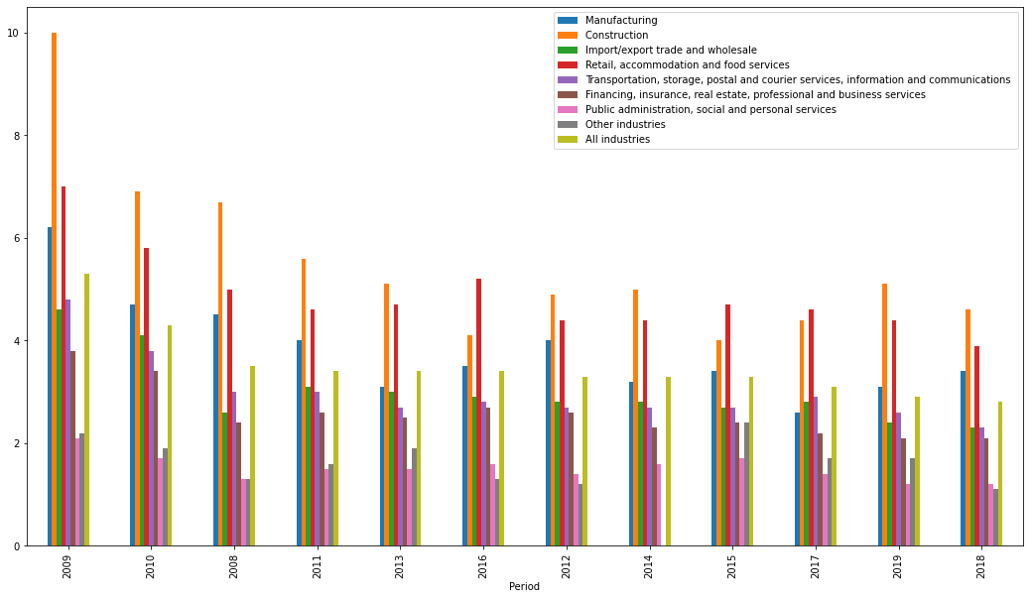
HKSAR EVENTS: What are the events(years) in HKSAR that has the highest impact on the unemployment rate ? Using group of industry data set

Slide 13
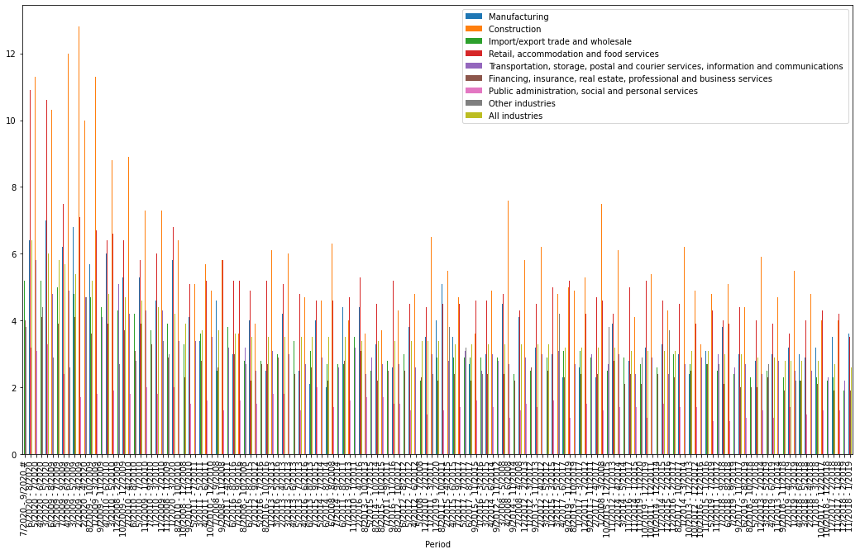
HKSAR EVENTS: What are the events(years) in HKSAR that has the highest impact on the unemployment rate ? Using group of industry data set

Slide 14
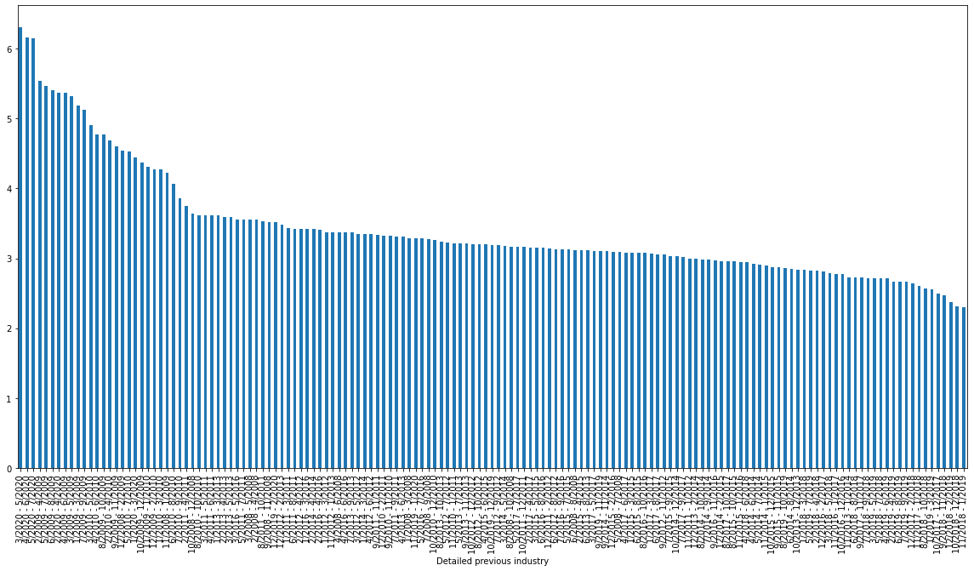
HKSAR EVENTS: What are the events(years) in HKSAR that has the highest impact on the unemployment rate ? Using specific industry data set

Slide 15
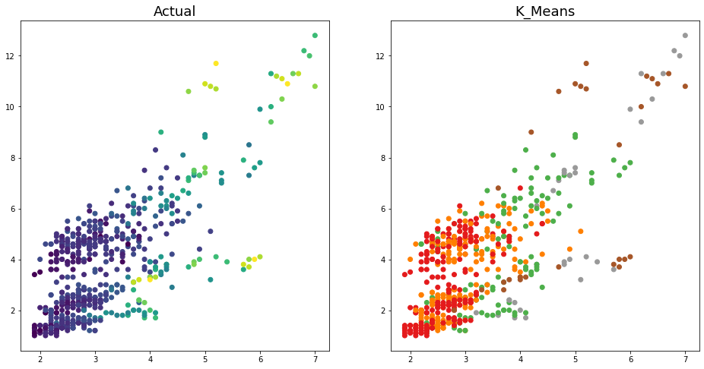
HKSAR EVENTS: What are the events(years) in HKSAR that has the highest impact on the unemployment rate ? K = 5

Slide 16
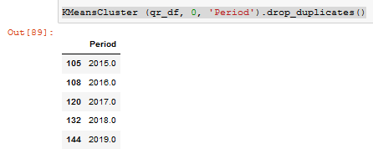
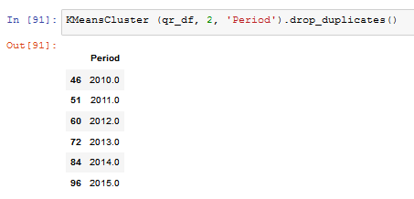
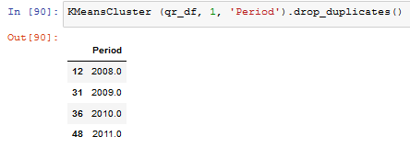
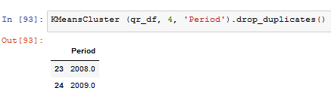
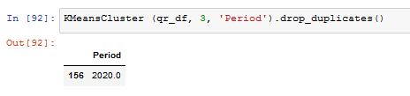
HKSAR EVENTS: What are the events(years) in HKSAR that has the highest impact on the unemployment rate ? K = 5
Cluster 1: Pandemic Years with Recovery Years
Cluster 0 and 2: PROTESTS Years
Cluster 4 and 5: PANDEMIC Years

Slide 17
PROTESTS vs. PANDEMIC:
What EVENT has the highest effect on the unemployment of HKSAR industries? Protests or Pandemic?

Slide 18
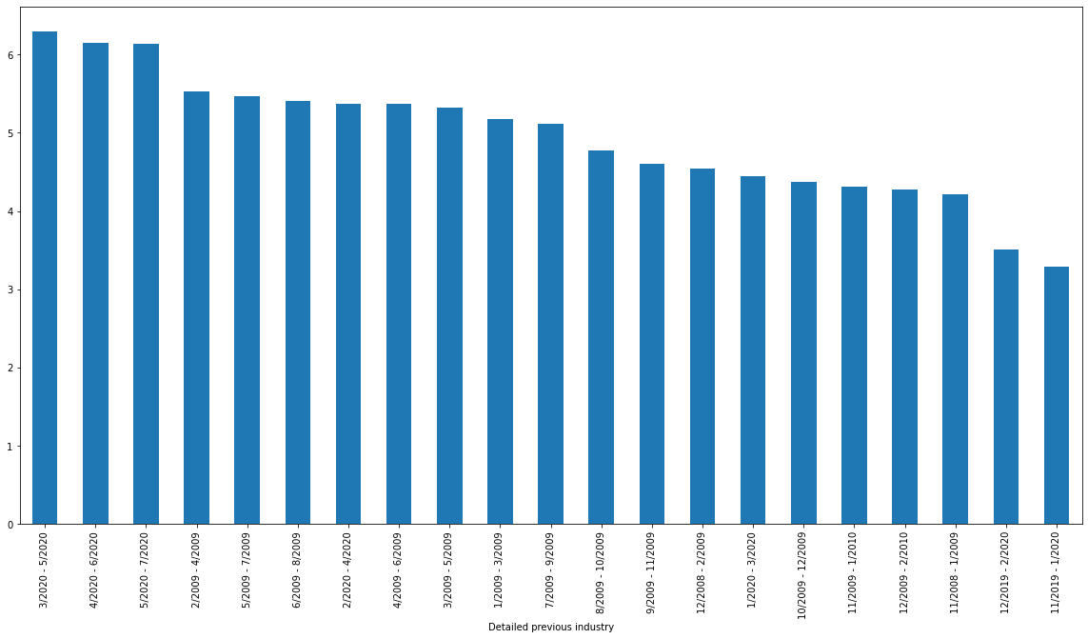
PROTESTS vs. PANDEMIC:
Pandemic years are 2009 (swine flu) and 2020 (Covid-19)

Slide 19
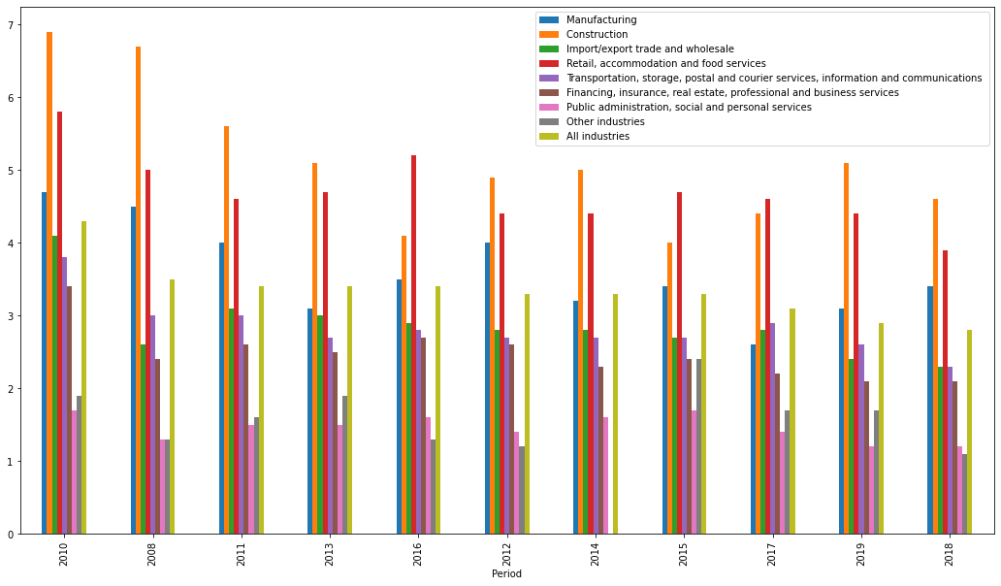
PROTESTS vs. PANDEMIC:
Protests years are 2008, 2010 – 2019. Protests years with high participation of HKSAR citizens are 2014 (Umbrella Revolution) and 2019 (Extradition Law Protests)

Slide 20
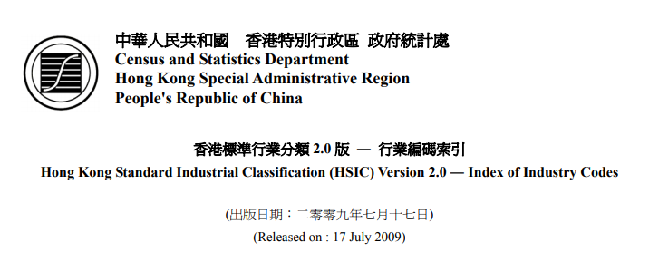
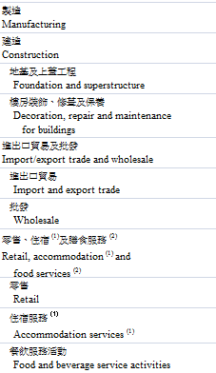
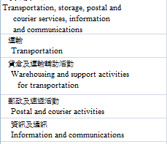
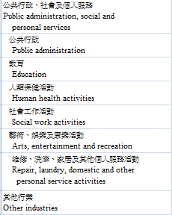
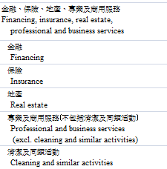
GROUP vs SPECIFIC INDUSTRIES:
Reference of Group and Specific Industries
1
5
7
2
3
6
4
8

Slide 21
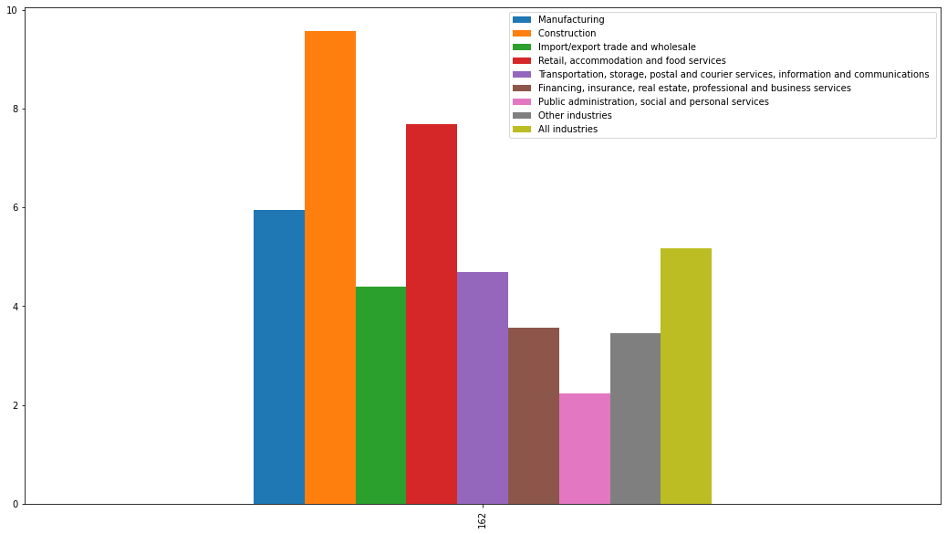
GROUP vs SPECIFIC INDUSTRIES:
Among the group of industries, what has the highest unemployment rate during the protests and pandemic events?
*Group of Industries
(all years)

Slide 22
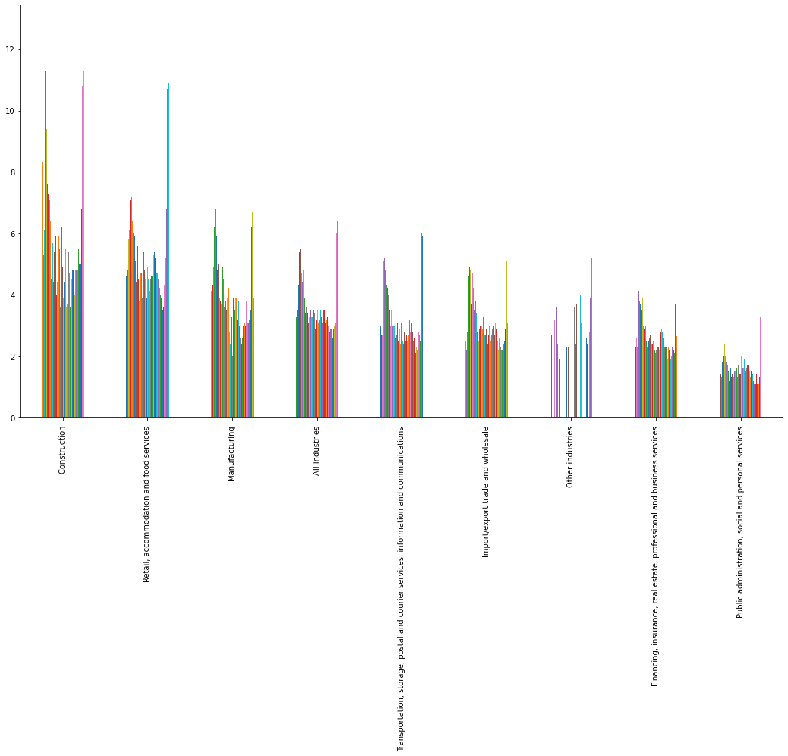
GROUP vs SPECIFIC INDUSTRIES:
Among the group of industries, what has the highest unemployment rate during the protests and pandemic events?
*Group of Industries
(all years)

Slide 23
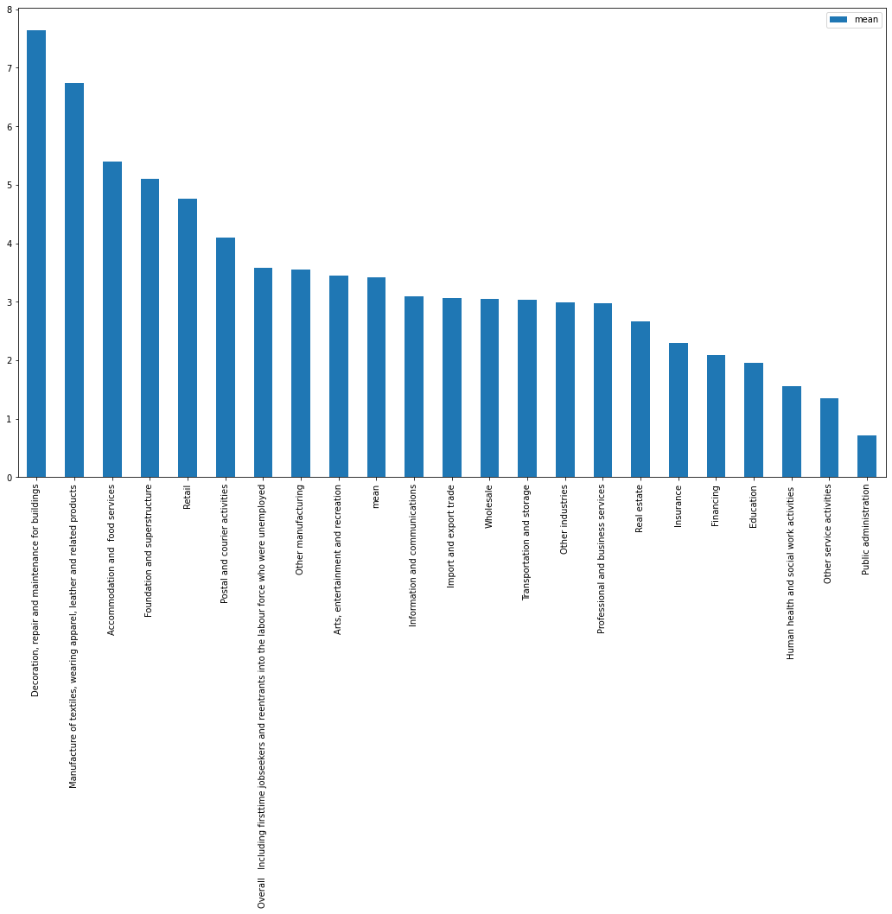
GROUP vs SPECIFIC INDUSTRIES:
Among the specific industries, what has the highest unemployment rate during the protests and pandemic events?
*Specific industries
(all years)

Slide 24
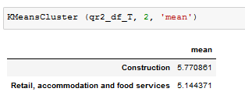
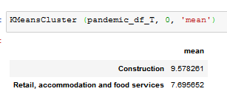
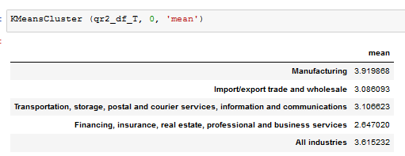
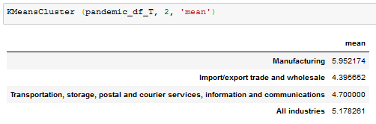
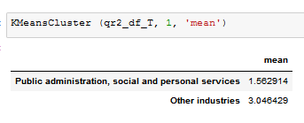

GROUP vs SPECIFIC INDUSTRIES:
Clustering the group of industries using K-Means where k = 3

Slide 25








GROUP vs SPECIFIC INDUSTRIES:
Clustering the specific industries using K-Means where k = 7

Slide 26






GROUP vs SPECIFIC INDUSTRIES:
Clustering the specific industries using K-Means where k = 7

Slide 27
IN CONCLUSION,
Among the HKSAR Events from the year 2008 – 2020, the pandemic events (yr 2009 and yr 2020) have the greater effect on the unemployment rate as compared to the protests events in HKSAR.
Between the two(2) pandemic events, bird flu in 2009 and COVID-19 in 2020, COVID-19 has the greater effect on the unemployment rate of HKSAR.
Among the HKSAR industries,
Group of Industries | Specific Industry | Weight
Construction Retail, accommodation and food services | Decorations, repair and maintenance of buildings Accommodation and Food Services | HIGHLY AFFECTED
Public Administration, Social and Personal Services | Public Administration Human health and social work services | LEAST AFFECTED

Slide 28
THANK YOU! ☺

Slide 29
GROUP vs SPECIFIC INDUSTRIES:
Comparing the group data set and specific data set

Slide 30
GROUP vs SPECIFIC INDUSTRIES:
Clustering the specific industries using K-Means where k = 7

